Slide 1
Suicide Prevention: Advisory Group
Monthly Meeting
February 27, 2024
Joe Constans

Slide 2
Agenda
Time | Item | Objective
3:00 – 3:05 | Review AMP Development | Discuss portfolio reorganization in ISRM Review portfolio purview statement Review priority setting process
3:05 – 3:35 | Initial Results from SP Priority Survey | Review survey data from SPRINT investigators Discuss themes of results
3:35 – 3:45 | Discussion Questions | How to collaborate with SMEs How to balance our funding priorities Timeframe for consensus panel
3:45 – 3:50 | Next Steps | Review next steps in priority development

Slide 3
ORD Reorganization and Development of a Suicide Prevention AMP

Slide 4
Portfolio Stand-up Progress
Based on the Suicide Prevention workplan, the team plans to complete the designated documents by the end of these months.
Completed
Future Items
Role Charter
Executive Committee Charter*
Program Announcements
Purview Statement*
Portfolio Analysis Report*
Portfolio Analysis PPT*
In Progress
Critical Research Priorities
Funding Model SOP
Position Description*
Portfolio Performance Metrics
Unit Charter
November – May 2024
May - June 2024
* currently under ISRM consideration following minor edits

Slide 5
Executive Committee Charter - Updates
Executive Steering Committee Charter Issues
  Concerns that investigators have advanced knowledge of issues discussed by committee.
    Addressed through conflict of interest policy
      Minutes published within week of meeting
      Meeting discussion will be broadcast via TEAMS or WEBEX
      Conflicted members will not be present for voting (closed session – no identification of individual voting and no broadcast)
Proposed members who are not Federal Employees
  If the committee includes non-federal members, then committee needs to be established as a subcommittee of an existing FACA committee
      Addressed through eliminating the one (proposed) non-federal employee.

Slide 6
Changes in approach to offering specific RFAs - The Problem
# | Current Issue | Details/Examples | Challenges Caused
1 | Large Volume in Service RFAs | BLRD: 24 CSRD: 18 HSRD: 11 RRD: 12 | Additional portfolios with their own RFAs could increase the volume further.
2 | Wide variation in application requirements | Budget caps and requirements vary across the Services Some Services use LOIs, some use pre-applications, but there is no requirement across ORD for these steps | Investigators will have difficulty in navigating different processes per portfolio, which will reduce collaboration.
3 | Duplicative offerings | All four Services have RFAs for Gulf War, CDA-2, RCS and DEI Three Services have RFAs for Suicide prevention, HBCU CDAs Two Services have RFAs for drug/biologics and device development | ISRM will have to navigate duplicative legacy projects, which can lead to inefficiencies when new projects are funded.
Notes:
So with that context in mind, we see some issues in this application review process that we anticipate will compound as we transition to portfolios.
One of these issues is the large volume of service RFAs. We foresee that additional portfolios with their own RFAs could increase the volume further.
Another issue is the wide variation in application requirements. We anticipate that investigators will have difficulty navigating different processes if portfolios operate differently and this will reduce collaboration.
Finally, we recognize there are duplicative offerings. This causes ISRM to navigate duplicative legacy projects, which can lead to inefficiencies when new projects are funded.
Ask Discussion Question

Slide 7





Changes in approach to offering specific RFAs - Solutions
In order to address the issues we have seen in the current process and the challenges they cause for ORD, we are proposing 5 solutions that will eliminate these challenges.
ORD-Wide RFAs
Program Announcements
RFA Standardization
Pre-Applications
Limited Portfolio RFAs
Notes:
And so to address these issues, we came up with 5 solutions. I will go into more details for each solution in the next slides.
#1, We want to use ORD-Wide RFAs that are based on research methodology as opposed to research topic
#2, In tandem with ORD-Wide RFAs, we want to send out Program Announcements to announce specific research topic areas each portfolio wants to request
#3, We will use a standardized RFA across all portfolios
#4, We will utilize pre-applications to collect for all RFA's
#5, We will utilize limited portfolio RFA's to capture RFA with unique needs

Slide 8
Changes in approach to offering specific RFAs - Solutions
Program Announcements: Provide clarity to investigators on how the VA will be reviewing and funding research.
Details | Challenge Solved
All Portfolios will create Program Announcements These will now serve the purpose of indicating the focus area ORD is interested in funding | Investigators will have less difficulty navigating different processes per Portfolio, which will increase collaboration.
By utilizing a combination of standardized ORD-Wide RFAs that are organized by research types with Program Announcements, ORD can increase efficiency while meeting VA research goals
Timeline Implications:
Each Portfolio will need to develop Program Announcements via Notices of Special Interest (NOSI) by July 1, 2024.
In July, ISRM will be posting the new ORD-Wide RFAs and each Portfolio’s NOSI’s to help inform investigators on overall VA research focus
Notes:
The 2nd solution is Program Announcements.
Our goal is to publish Program Announcements to indicate special interest areas with funds committed or numbers of projects to be funded. The idea is that because RFAs would now be developed based on research type, we would need to use Program Announcements to announce our interest areas, ultimately reducing the volume of RFAs
Ask Discussion Question

Slide 9
Last Meeting Recall: Rapid (and Rigorous) Approach to Identifying AMP Research Priorities
AMP Priorities for RFA
Measures of Impact
Exec. Committee
Phase I: Identify research gaps and unanswered questions (e.g., SPM review, evidence inventories or reviews, VA program office strategic plans)
Phase II: Refine Priorities using concurrent processes: national surveys/live voting & focus groups with Consumer, Provider, Leader, Investigator groups
Phase III: Delphi consensus panel with interested party representatives rank priorities on urgency, impact, feasibility, identify impact metrics
Survey and focus group input inform Delphi consensus panel discussion with representatives from different groups
Existing reviews inform focus group, survey questions
Current Phase
General principles:
Priorities should reflect the research translation spectrum (e.g., T1-T4)
In-depth feedback from focus groups to identify topics not previously listed
Broad representation across interested parties via surveys, voting on top priorities
Perspectives from the front line
References:
Aligning quality improvement efforts and policy goals in a national integrated health system - Braganza - 2022 - Health Services Research - Wiley Online Library;
Health System Research Priorities for Children and Youth With Special Health Care Needs - PubMed (nih.gov),
Research Lifecycle to Increase the Substantial Real-world Im... : Medical Care (lww.com)

Slide 10
Suicide Prevention Survey Results
- SPRINT Investigators

Slide 11
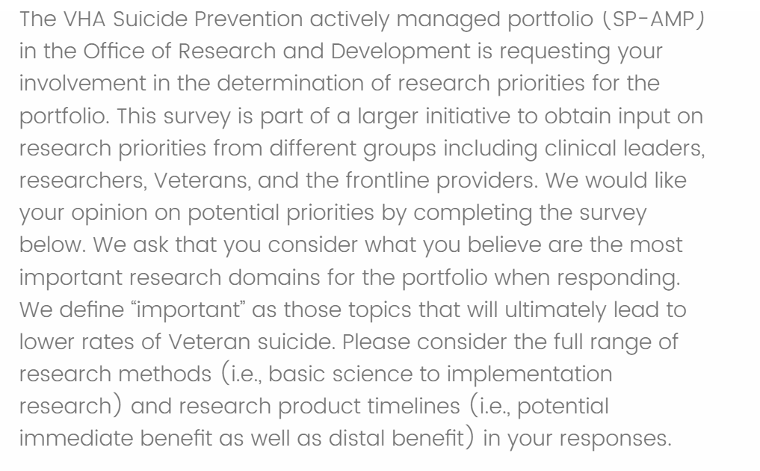
Survey
Preview

Slide 12
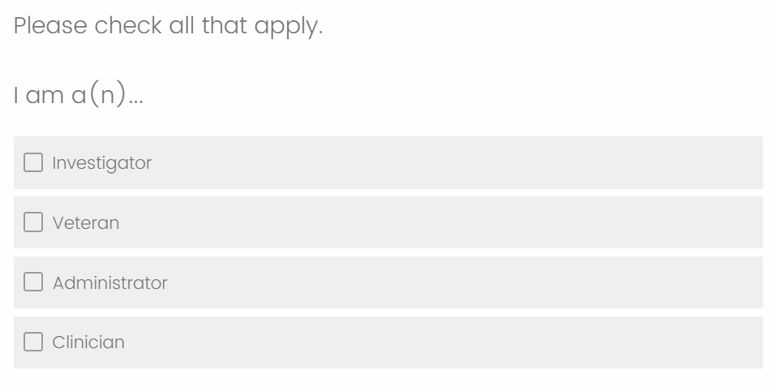
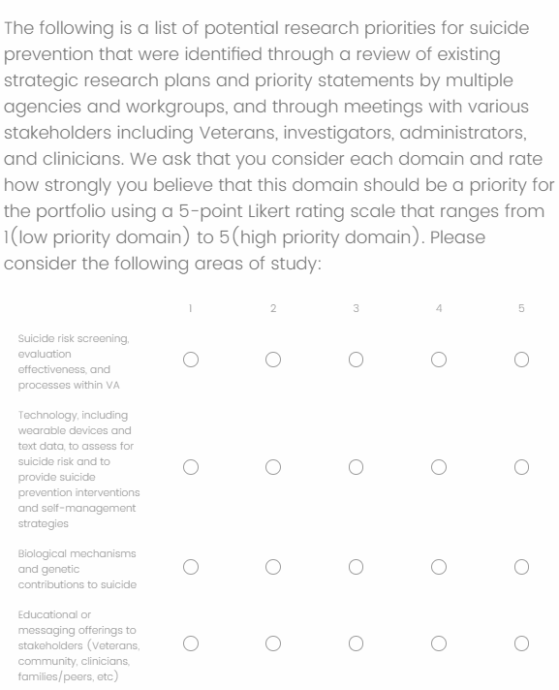
Survey - Preview

Slide 13
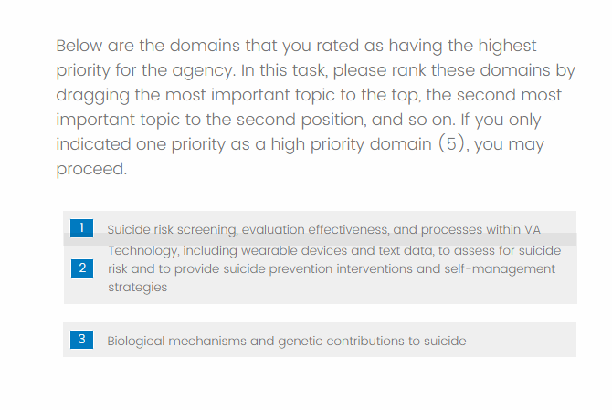
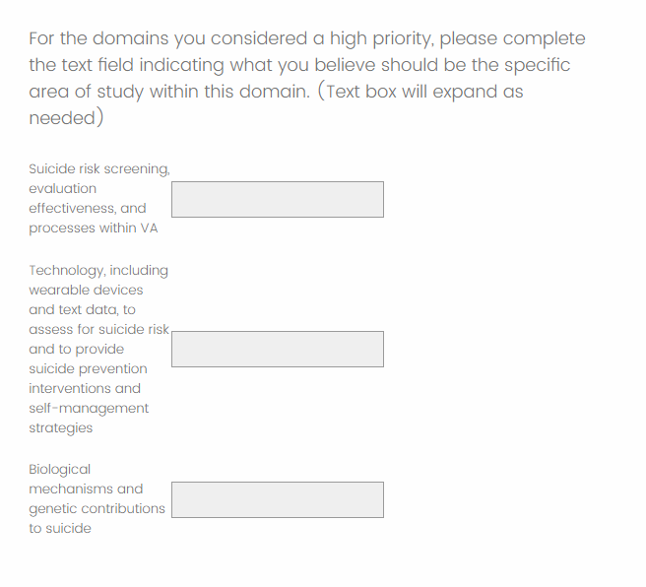
Survey - Preview

Slide 14
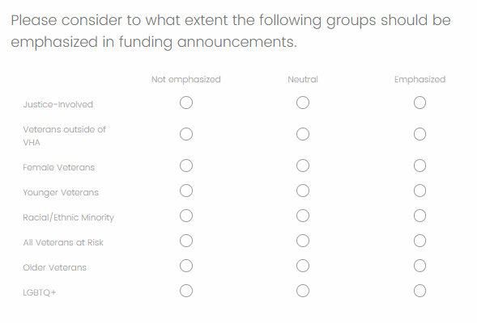
Survey - Preview

Slide 15
Suicide Prevention Priority Survey
Distribution Group | Survey Response Timeline
SPRINT Investigators | 2/14 – 2/23
VEC Veterans | 2/21 - Current
CMHOs | TBD
Reviewing this dataset (n = 68)
Questions
General Identity
Research Priority Domain Rating
High Priority Domain Ranking
High Priority Domain Example Studies
Veteran Groups to Emphasize in Funding Announcements
Identity – Select all that apply | Percentage
Investigator | 91%
Veteran | 1%
Administrator | 9%
Clinician | 35%

Slide 16
Research Priority Domain Rating
Rank | Research Priority Domains | Average
1 | Lethal Means Safety approaches to suicide prevention | 4.3
2 | Community-based interventions for suicide prevention | 4.24
3 | Psychotherapies and other non-somatic interventions for suicide prevention | 4.18
4 | Family and social network-based interventions and postventions | 4.07
5 | Suicide risk screening, evaluation effectiveness, and processes within VA | 3.79
6 | Technology, including wearable devices and text data, to assess for suicide... | 3.51
7 | Educational or messaging offerings to stakeholders (Veterans, community, cl... | 3.38
8 | Machine-based suicide risk algorithms that utilize large existing data sets... | 3.31
9 | Psychopharmacological and other somatic interventions (e.g., TMS) to preven... | 3.19
10 | Biological mechanisms and genetic contributions to suicide | 2.76
Ranking is based the domains averaged priority score.
The rating scale ranged from 1 (low priority domain) to 5 (high priority domain).

Slide 17
High Priority Domain Ranking – Raw Data
Rank | Research Priority Domains - Ranking | Count of #1 Rankings
1 | Psychotherapies and other non-somatic interventions for suicide prevention | 13
2 | Lethal Means Safety approaches to suicide prevention | 7
3 | Community-based interventions for suicide prevention | 4
4 | Family and social network-based interventions and postventions | 4
5 | Biological mechanisms and genetic contributions to suicide | 2
6 | Machine-based suicide risk algorithms that utilize large existing data sets to improve risk accuracy or developing precision-medicine approaches to suicide prevention | 2
7 | Suicide risk screening, evaluation effectiveness, and processes within VA | 2
8 | Educational or messaging offerings to stakeholders (Veterans, community, clinicians, families/peers, etc) | 1
9 | Psychopharmacological and other somatic interventions (e.g., TMS) to prevent suicide | 1
10 | Technology, including wearable devices and text data, to assess for suicide risk and to provide suicide prevention interventions and self-management strategies | 0
Ranking based exclusively on the number of times a topic was placed at the highest level (#1 Rank) during the ranking task.

Slide 18
High Priority Domain Ranking – Weighted Data
Rank | Research Priority Domains - Ranking | Weighted Ranking
1 | Community-based interventions for suicide prevention | 467
2 | Family and social network-based interventions and postventions | 374
3 | Psychotherapies and other non-somatic interventions for suicide prevention | 350
4 | Lethal Means Safety approaches to suicide prevention | 342
5 | Technology, including wearable devices and text data, to assess for suicide risk and to provide suicide prevention interventions and self-management strategies | 209
6 | Psychopharmacological and other somatic interventions (e.g., TMS) to prevent suicide | 200
7 | Machine-based suicide risk algorithms that utilize large existing data sets to improve risk accuracy or developing precision-medicine approaches to suicide prevention | 145
8 | Suicide risk screening, evaluation effectiveness, and processes within VA | 138
9 | Biological mechanisms and genetic contributions to suicide | 72
10 | Educational or messaging offerings to stakeholders (Veterans, community, clinicians, families/peers, etc) | 57
Ranking was based on weighted method:
- A Ranking of 1 gives the domain a score of 10, down to a Ranking of 10 gives the domain a score of 1. Combining all rankings across all responses results in these overall ranks.

Slide 19
High Priority Domain Example Studies
Domains | Selected Free Responses
Biological mechanisms and genetic contributions to suicide | Approx half of a person's total risk for suicide is genetic in nature, but the biological basis of suicide is largely unknown. This is one of the key areas that will have to be understood better if we ever want to truly get a handle on suicide prevention and treatment of high risk individuals. I think we need to study the biomarkers (e.g., DNA methylation) of changes in suicide risk as measured by validated scales such as the BSS.
Suicide risk screening, evaluation effectiveness, and processes within VA | Identification of veterans at low to moderate risk who should be targeted through public health approaches, particularly those outside of mental health evaluation of effectiveness of traditional screening within VA. Does filling out a CSSRS impact clinical outcomes
Machine-based suicide risk algorithms that utilize large existing data sets... | Can risk algorithms be developed that would eliminate need for universal screening and result in screening based on fluid risk as identified through machine-based processes.
Technology, including wearable devices and text data, to assess for suicide... | leveraging technologies and EMA data to better understand fluctuations in suicide risk and also potential points of intervention
Community-based interventions for suicide prevention | I agree with those who note that VA work must be paired with community interventions to help those who will never enter a VA (the majority of suicides). We know very little in this area. Developing strategies to engage non-VHA users in SP programming at VA including LMS counseling. building collaborations with community partners and leveraging community resources to create shifts/changes in suicide outcomes over the longer term

Slide 20
High Priority Domain Example Studies
Domains | Selected Free Responses
Psychopharmacological and other somatic interventions (e.g., TMS) to preven... | Ketamine large study needs to be done. Development ant testing of psychedelics
Psychotherapies and other non-somatic interventions for suicide prevention | We need more work aimed at figuring out the most cost effective approaches for reducing suicide risk through therapy. It's not clear how much CBT-SP does over and above safety planning alone; group format's need to be explored as well as web-based and digital interventions. We need to try to get the interventions that are known to work to as many at risk veterans as possible. Developing novel psychotherapies to address suicide risk and conducting randomized controlled trials to build their evidence base Developing a large network of sites for large multi-site clinical trials.
Lethal Means Safety approaches to suicide prevention | Focus resources on rapidly implementing and assessing the impact of current best practice lethal means safety for suicide prevention. Examining the impact of Lethal Means Safety Counseling Interventions on Behavior (e.g., use of safe storage); examining the impact of LMS programs and distribution of safe storage on suicidal behaviors and death
Family and social network-based interventions and postventions | Interventions to improve support and helpfulness of family members and professional caregivers in their efforts to support a Veteran at risk for suicide
Educational or messaging offerings to stakeholders (Veterans, community, cl... | Increase messaging to destigmatize suicide and increase help seeking, as well as increased messaging on resources and support options As messaging is a universal prevention strategy, having more effective messaging especially for those who are currently at low-to-moderate acute and chronic risk to increase help-seeking may help us to reach a broader risk group.

Slide 21
Veteran Groups to Emphasize in Funding Announcements
Rank | Research Priority Domains - Ranking | Weighted Ranking
1 | Veterans outside of VHA | 2.76
2 | LGBTQ+ | 2.73
3 | Female Veterans | 2.65
4 | All Veterans at Risk | 2.6
5 | Racial/Ethnic Minority | 2.59
6 | Younger Veterans | 2.54
7 | Justice-Involved | 2.46
8 | Older Veterans | 2.44
Observation and recommendation:
Minimal variance between subgroups
Recommend NOT using this information in any initial funding announcement
Identification of certain subpopulations might best be realized through other means (e.g., Annual Report)

Slide 22
Discussion

Slide 23
Next Steps and Discussion Questions
Complete collection of survey response
  VEC – 2/29/2024
  SPC VISN Leads / CHMOs – March 8th
  Front line clinicians - ?
Synthesize Data / Determine topics for SME input
  Working subgroup – Dobscha, Strickland, Constans (?)

Slide 24
Next Steps and Discussion Questions
3. Identify Research Gaps for NOSI
  SOTA versus solicit feedback from multiple SME
    Benefits of Solicit multiple SMEs
      Broader range of feedback
      Avoid COI related to SME study area
      Logistical benefits
Hold Executive Session to vote on priorities
  May 28
5. NOSI (internal to ORD)
  Publish July 1
  Determine $ amount

Slide 25
Next Steps and Discussion Questions
How to collaborate with SMEs
  Selecting SMEs based on top priorities
  SMEs vs SME groups
  Seeking gaps in topics
How to balance our funding priorities
  Development of Notices of Special Interest
Timeframe for consensus panel
  May 2024?

Slide 26
Next Steps

Slide 27
Next Steps
Collection and Analysis of Data from remaining Survey groups
Selection of SMEs for Panel Discussion
  Determination of Questions for each Topic Area
Scheduling Consensus Panel Meeting

Slide 28
Appendix

Slide 29
Critical Research Priority Setting – Evaluation of Priorities
Defense Health Agency (DHA)
DHA 2020 Prioritized Research Gaps Report for Suicide Prevention Topics | The 2020 Research Gaps Report: Suicide Prevention Research Priorities | Health.mil
Screening, Evaluation, Risk Determination, and Referral to Treatment | Lethal means safety interventions.
Risk and Protective Factors | Crisis response plans/safety planning
Non-pharmacologic Interventions | Implementation of cognitive-behavioral therapy for suicidal ideation.
Pharmacologic Interventions | Technology-based interventions and adjuncts for treatment.
Community-based Interventions | Dialectical behavior therapy (DBT) for suicidal ideation
Post-acute Care Approaches | Caring contact
Evaluation of Priorities
Process | Gather all 186 priorities across all 26 sources and create “keyword” categories based on the priority language. With the resulting keyword categories, priority statements were drafted to summarize the priorities in that group (on the following slide)
Decision Rule | 5 or more occurrences of a keyword within the priorities results in a new “category”
Example | “Risk” occurred 15 times across the priorities, including the ones highlighted in the source to the left.

Slide 30
Priority Questionnaire – Summary Statistics
Summary Statistics
Count | 54
Mean | 6.4
Median | 4
Evaluation of Priorities
Process | Review Priorities #1 - #5 for all records and code into a cell of the priority matrix. In order to apply a weight to the #1 through #5 priorities, #1 was given a weight of 5, #2 was given a weight of 4, and so on.
Decision Rule | Each response was coded based on the destination cell of the category and the population grouping. Any responses that was not specific to a category or populations was designated into a “cross-cutting” group. If there was a specific reference to multiple categories or populations, the priority was coded into both.
Example | “Improve understanding of female veteran suicide risk; test interventions and upstream opportunities to reduce risk (e.g., preventing/treating MH, SU, IPV)” was coded with F12 [Female Veterans, Cross-Cutting] H12 [Social Determinants of Health, Cross-Cutting]. As this was a Priority #2, it was given a weight of “4” in each F12 and H12 in the final Priority Matrix calculations.

Slide 31
For consideration by the group
Suggestions regarding weighting of quantitative and qualitative data to identify content domains for consideration?
Thoughts on ranking or rating of content domains in the survey? That is, what do you see as the benefits of ranking over rating and visa versa?
How many domains should be considered on the survey?
What are the recommendations regarding specificity in the domains in survey?
  For example, if Lethal Means Safety
    Should we leave it at the content domain (Lethal Means Safety)
    Or should we present different options regarding intersection between population and methods (i.e., LMS in primary care; LMS in community)

Slide 32
Phase 1: Critical Research Priority Setting for Suicide Prevention
American Foundation for Suicide Prevention
American Psychological Association
CDC
Defense Health Agency (DHA)
Department of Defense
Indian Health Service
National Action Alliance for Suicide Prevention (NAASP)
NAMI
NIMH
SAMSHA
VHA
White House
Peer-reviewed Research
Utilizing these sources as a base, the team gathered priorities from a total of 26 sources, resulting in 186 cumulative priorities
These priorities were coded into research categories to reflect method/procedure and characteristic of prioritized population.

Slide 33
Phase 1: Developing the Priority Matrix
Category | Cross-Cutting | Firearms | Older Veterans | Younger Veterans (22-34) | Female Veterans | Race/Ethnicity | SDOH | Substance Abuse | Medical Disease | TBI | Justice Involvement | LGBTQ | Trauma/ Moral Injury | Mental Health
Biology/ Genomics/Brain
Risk Factor Assessment/ Screening - clinician/questionnaire
Risk Factor Assessment - machine learning
Continuous monitoring
Family /Social Network
Pharmacotherapy and other Somatic Interventions
Psychotherapy and other Non-Somatic Interventions
Community Interventions
Education, Training, & Messaging
Precision Medicine ?
Cross-Cutting
Postvention
First Column – Categories reflect Method or Procedure.
First Row – Categories reflect Risk Factors
A priority could be placed into a cell reflecting risk factor and method.

Slide 34
Phase 2: Gathering input from various stakeholders
Priority Questionnaire Distribution to Field
  A survey was sent out to investigators within the SPRINT database. We collected responses from 54 respondents, each listing ranked research priorities. These priorities were coded into the categories developed in Phase 1.
Veteran’s Engagement Council Discussion
  Our team met with a Veteran’s Engagement Council in December to hold a discussion and gather research topics of interest to veterans. The topics covered in the discussion were also coded into the categories developed in Phase 1.
VISN Suicide Prevention Lead – Open Discussion
  Today, we are hoping to review progress on suicide prevention research priorities and gather your input and feedback as we continue to refine the priorities.

Slide 35
Phase 2: Priority Questionnaire Distribution to Field
Greetings VA Suicide Prevention investigators,
Beginning October 1, 2024, suicide prevention research will be housed within the Suicide Prevention Actively Managed Portfolio (SP AMP). The SP AMP team is currently working with an Executive Steering Committee to establish governance policy and processes for the SP AMP and to establish initial priority areas for VA suicide prevention research.
The priority setting efforts will follow a strategy developed by QUERI which seeks input from multiple stakeholders throughout the priority setting process. As part of our initial efforts, we are asking for your assistance in identifying topic areas that you believe are important to advance suicide prevention efforts in VA. To help us gather a thorough body of topic areas, we ask that you identify up to 10 research areas for which there are significant gaps in extant knowledge and for which research support is needed.
If you are willing to assist us in these initial efforts to identify possible priority areas, please click on this link which will provide further instruction. Please provide feedback as soon as possible but no later than November 17th.
Thanks in advance for your willingness to help. We will be providing more information to the field as this process advances.

Slide 36
Phase 2: Populating the Priority Matrix
Initial Categorization of Priorities Identified by Survey Respondents
Category | Cross-Cutting | Firearms | Older Veterans | Younger Veterans (22-34) | Female Veterans | Race/Ethnicity | SDOH | Substance Abuse | Medical Disease | TBI | Justice Involvement | LGBTQ | Trauma/ Moral Injury | Mental Health | SUM
Biology/ Genomics/Brain | 45 | 0 | 0 | 0 | 0 | 0 | 0 | 0 | 0 | 0 | 0 | 0 | 0 | 0 | 45
Risk Factor Assessment/ Screening - clinician/questionnaire | 25 | 0 | 5 | 5 | 0 | 0 | 8 | 0 | 10 | 0 | 0 | 0 | 0 | 3 | 56
Risk Factor Assessment - machine learning | 22 | 0 | 0 | 0 | 0 | 0 | 0 | 0 | 0 | 0 | 0 | 0 | 0 | 0 | 22
Continuous monitoring | 13 | 0 | 0 | 0 | 0 | 0 | 0 | 0 | 0 | 0 | 0 | 0 | 0 | 0 | 13
Family /Social Network | 13 | 6 | 0 | 0 | 0 | 0 | 0 | 0 | 0 | 0 | 0 | 0 | 0 | 0 | 19
Pharmacotherapy and other Somatic Interventions | 29 | 0 | 0 | 0 | 0 | 0 | 0 | 0 | 0 | 0 | 0 | 0 | 0 | 1 | 30
Psychotherapy and other Non-Somatic Interventions | 42 | 25 | 0 | 0 | 0 | 0 | 22 | 0 | 0 | 0 | 0 | 5 | 5 | 1 | 100
Community Interventions | 56 | 7 | 0 | 5 | 0 | 0 | 0 | 0 | 0 | 0 | 0 | 0 | 0 | 0 | 68
Education, Training, & Messaging | 17 | 10 | 0 | 0 | 0 | 0 | 0 | 0 | 0 | 0 | 0 | 0 | 0 | 0 | 27
Precision Medicine ? | 6 | 0 | 0 | 0 | 0 | 0 | 0 | 0 | 0 | 0 | 0 | 0 | 0 | 0 | 6
Cross-Cutting | 5 | 49 | 34 | 3 | 25 | 16 | 32 | 2 | 4 | 4 | 5 | 31 | 6 | 18
Postvention | 16 | 0 | 0 | 0 | 0 | 0 | 0 | 0 | 0 | 0 | 0 | 0 | 0 | 0 | 16
SUM |  | 97 | 39 | 13 | 25 | 16 | 62 | 2 | 14 | 4 | 5 | 36 | 11 | 23

Slide 37
Phase 2: Potential Priorities as identified through Matrix coding
Category | Example Responses to Unstructured Survey
Psychotherapy and other Non-Somatic Interventions | Multi-site RTC to determine interventions most likely to prevention suicide death.
Firearms, Lethal Means Safety | Does LMS counseling in primary care settings reduce suicide deaths?
Community Interventions | What community interventions effectively promote safe storage?
Social Determinants of Health | Do programs that address SDOH (i.e., providing housing to unhoused Veterans) decrease suicide for those at risk?
Risk Factor Assessment – Screening | How can algorithms be improved to include dynamic risk factors of suicide?
Biology, Genomics, Brain | Neuroimaging (fMRI, DTI, MRS) studies of suicide: emphasis on measures of impulsivity, negative affect processing, reward, decision making.
Older Veterans | Developing age-specific interventions for older Veterans.
LGBTQ+ | Interventions for sexual minority / LGBQ veterans.

Slide 38
Phase 2: Veteran’s Engagement Council Discussion
Key Questions for Audience:
What suicide prevention research topics come to mind as most important for Veterans from your perspective?
Are there specific patient populations it would be important to study (if this has not come up)?
Are there any research topics you don’t think are as high a priority?
Are there particular topics within this area that come to mind that would be important for VA researchers to work on?
Research Priorities Discussed during Meeting
Hard to Reach Veterans (Isolating Veterans/ Veterans not in VA care/ Rural Veterans / Transitioning to civilian)
Continuity of Care*
Community Research (including family)
Developing Novel Treatments (including provider perspective)
Moral Injury/Spiritual
Lethal Means Safety
Messaging
Peer Support
Messaging
Data Studies
Racial/Ethnic/Sexual Minorities
Brain/TBI/Genomics (low priority)
* - category not identified through investigator survey

Slide 39
Phase 2: VISN Suicide Prevention Lead – Open Discussion
Key Questions for Audience:
What areas in suicide prevention do you think needs more research to support your clinical decision-making?
How does your program implement current research evidence or data regarding assessing suicide risk? What would make risk assessment processes or resulting risk information more useful or actionable?
How do you use the information you have now regarding effectiveness of suicide prevention interventions and treatments? What new information would help your program make evidence-informed treatment planning decisions?
Are there certain patient characteristics that are important to study or to include in VA research?
Research Priorities Discussed during Meeting
Risk Identification Process*
  Needs modification
  Clinician burden too high
Clinical Trial Feasibility*
  Psychotherapy
  Small trials will not advance practice
Community Interventions
Education, Training, and Messaging
Firearms, Lethal Means Safety
Safety Planning
Older Veterans
Female Veterans
* - similar category / different perspective

